Slide 1
Where should I
move?
By Preet Mishra

Slide 2
Introduction
Business Problem:
People often find themselves in a situation where they are looking for a place to move to and they don’t have any reliable source to look for the best neighbourhood. People in that situation tend to go to online forums, ask someone for suggestions and use other means to conclude their decisions.
For solving this problem, I will use the Foursquare location data to get the data of each neighbourhood and cluster them together.

Slide 3
Objective:
To find a neighbourhood for person X who wants to move to Toronto based on his/her preferences of venues.

Slide 4
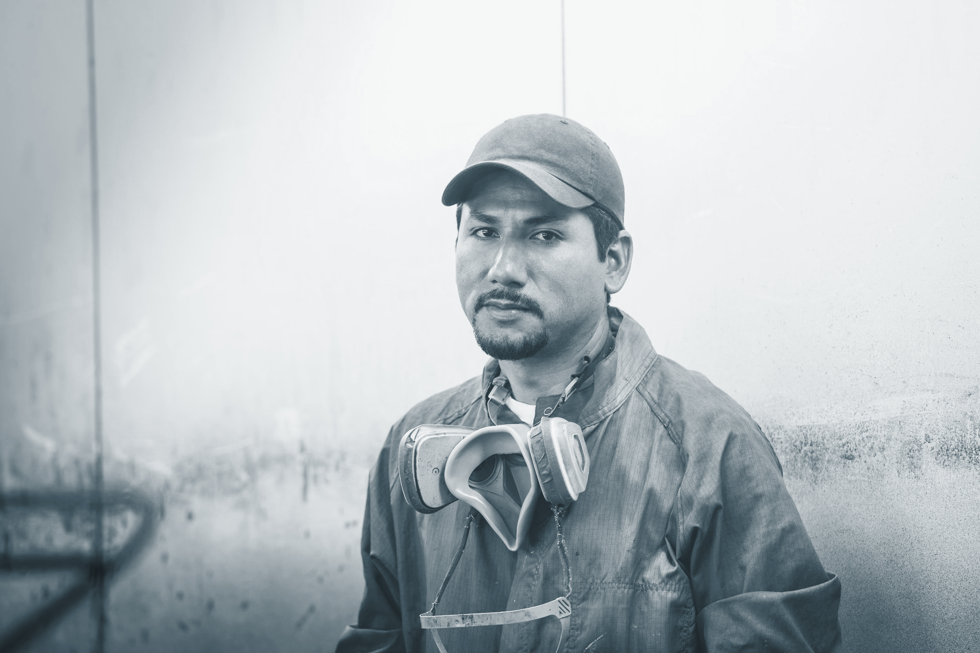

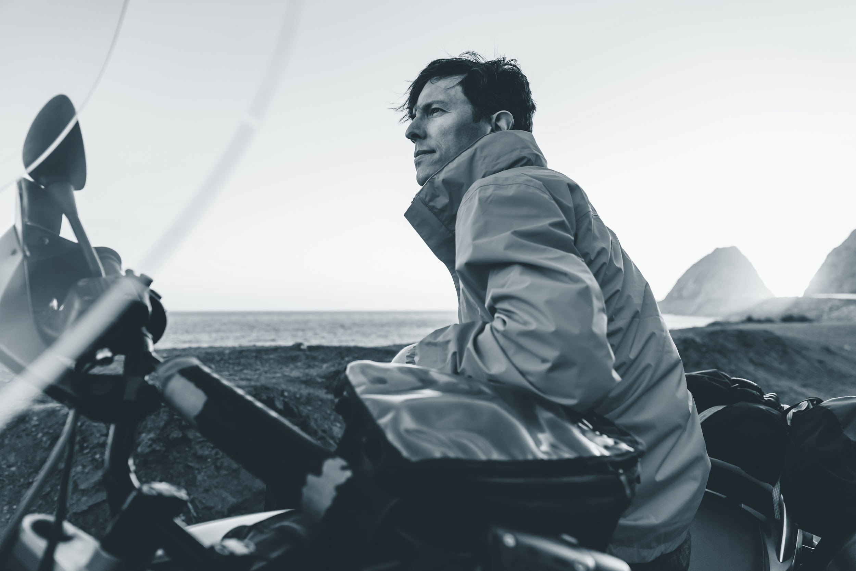
Target audience and Stakeholders
A potential client could be someone who is looking for a neighbourhood to move to in Toronto.
Stakeholders:
Government of Canada (to help an immigrant or a person who is looking for a neighbourhood to settle in Toronto).
End user.

Slide 5
Why to care?
This project will try to ease the whole process by providing reliable data and a mean that they can use to select a neighbourhood for the people of Toronto on the basis of their preferences of venues.

Slide 6
Data acquisition and cleaning
List of postal codes of Canada: M from Wikipedia. (https://en.wikipedia.org/wiki/List_of_postal_codes_of_Canada:_M)
Coordinates of the Toronto Neighbourhoods from csv file. (http://cocl.us/Geospatial_data)
Foursquare Location data. (http://foursquare.com/)
Cleaned data had 3 features.
Rows which were not available were removed.

Slide 7
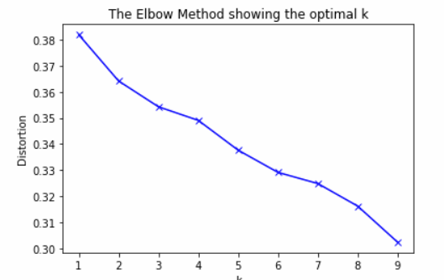
K-means clustering for clustering the neighbourhoods
Based on the basis of common venues k-means clustering Machine Learning is used, which is unsupervised, in order to cluster the neighbourhoods together.
The k = 5 was found optimal using elbow method.

Slide 8
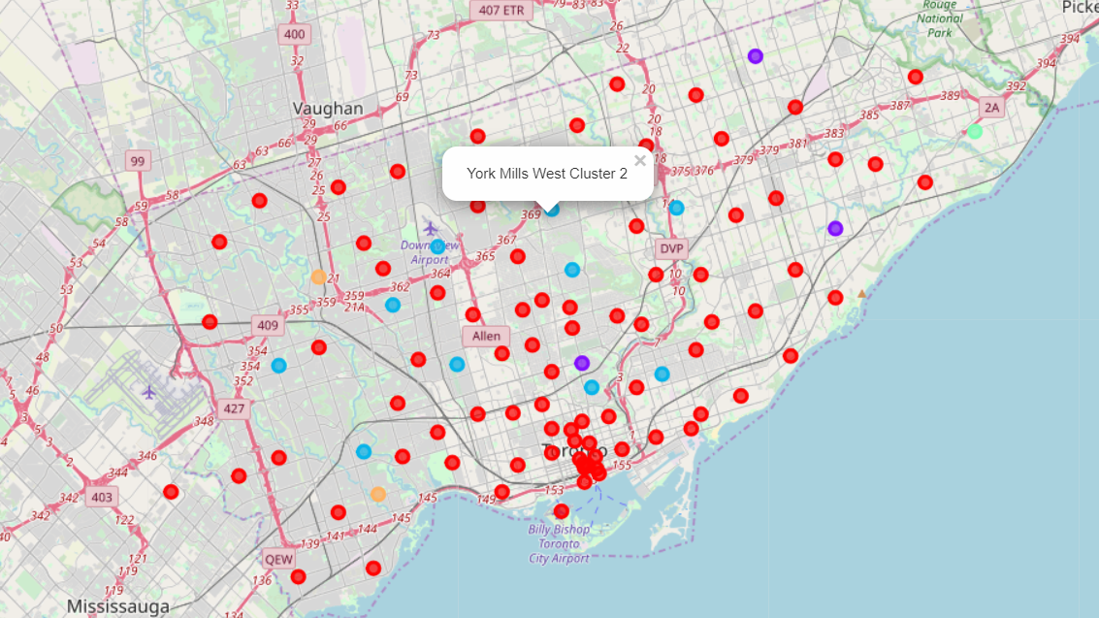
Visualization of different clusters

Slide 9
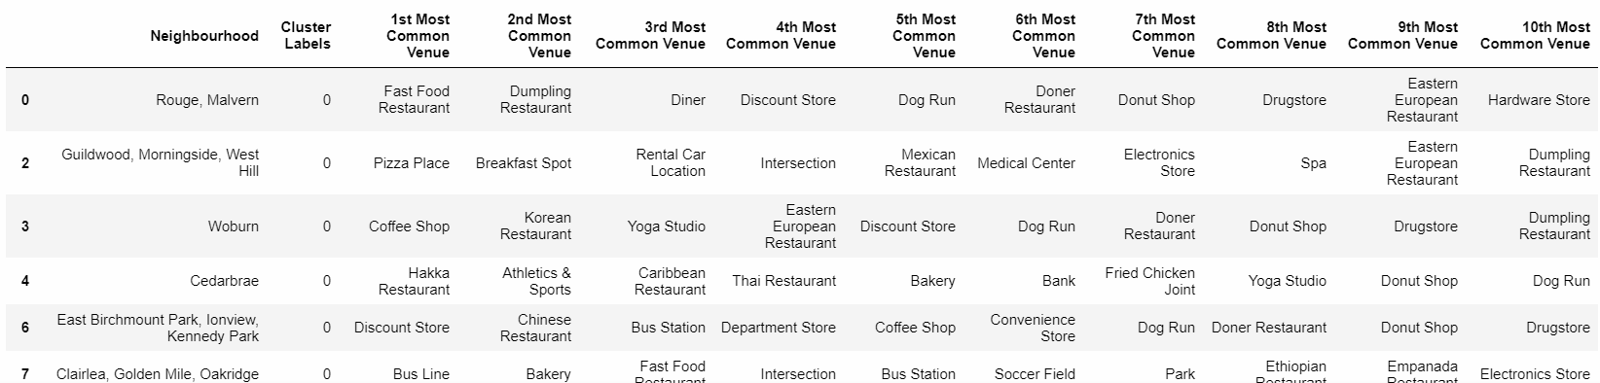
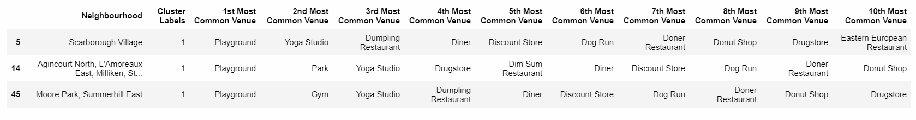
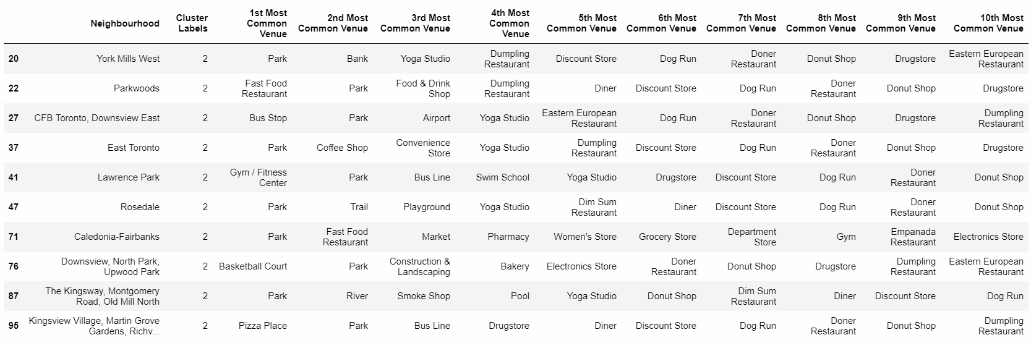
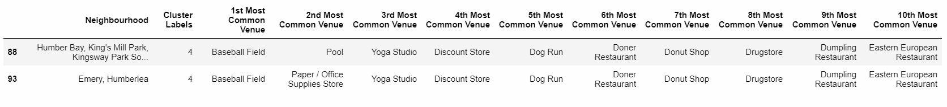
Clusters

Slide 10
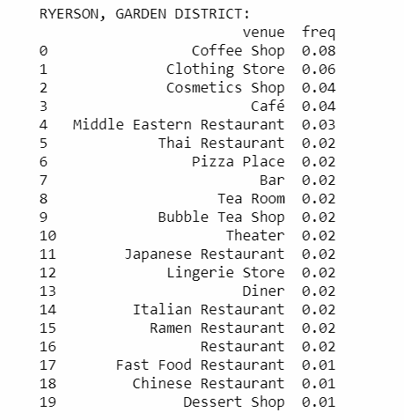
Representative of Cluster 1

Slide 11
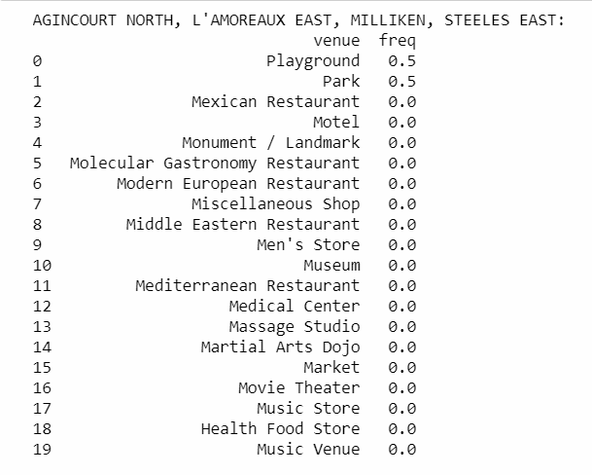
Representative of Cluster 2

Slide 12
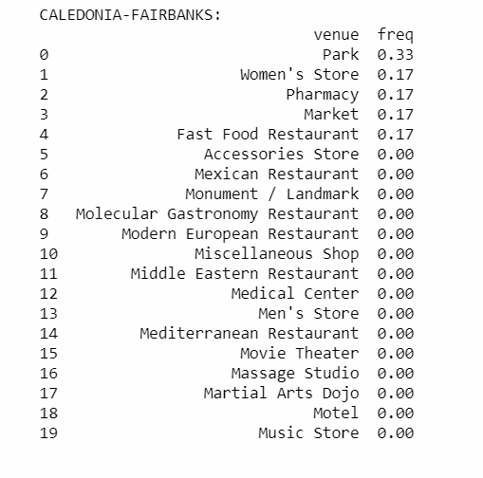
Representative of Cluster 3

Slide 13
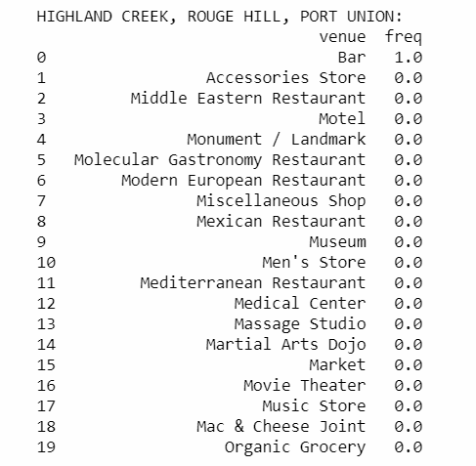
Representative of Cluster 4

Slide 14
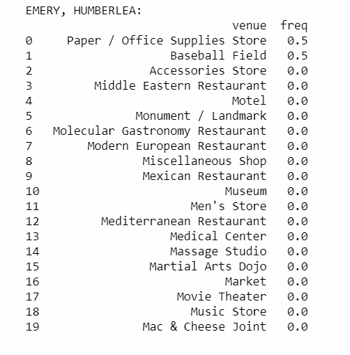
Representative of Cluster 5

Slide 15
Conclusion and
future directions
Using this results a person X who wants to move to Toronto can choose a neighbourhood from different clusters. For choosing a particular cluster, X can analyze provided cluster's representative based on his/her preferences of venues.
Each neighbourhood of the cluster is most likely to have similar characteristics as the cluster's representative.
More cities can be added.

